Slide 1
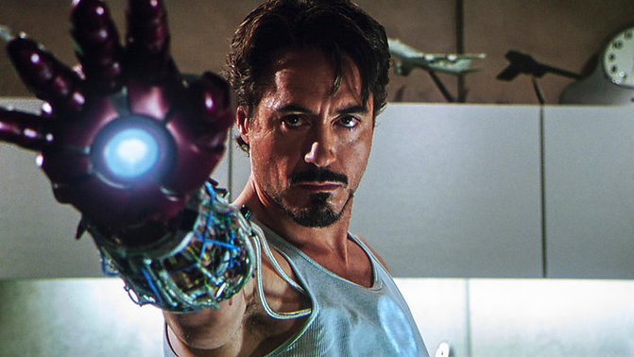
Movie Plot + Character Intelligence using RAG
Retrieval-Augmented Generation for Deep Movie Understanding
Team Members Natural Language Processing
Deepak Avinash Dr Khaled Sayed
Satish Kumar Jonna

Slide 2
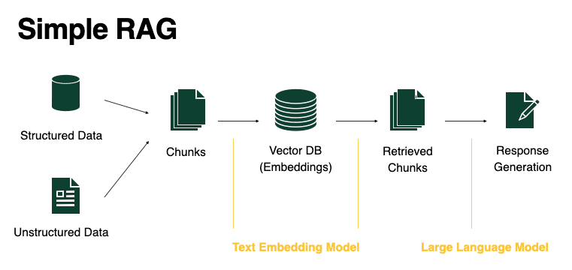


PROJECT TOPIC & DOMAIN
Project Topic:
This project develops a Retrieval-Augmented Generation (RAG) system that answers questions about movies by understanding:
Plot structure
Character motivations
Emotional depth
Domain / Corpus:
Movie plot summaries (Wikipedia / IMDb)
Movie scripts
Character descriptions
Dialogue datasets
Example Queries:
Why did Joker become violent?
What motivates Tony Stark?
Explain the theme of Interstellar

Slide 3
Problem Statement
Movies are narratively rich filled with layered characters, psychological arcs, and complex themes. Standard language models struggle here in critical ways:
Without grounding in real movie data, even powerful LLMs produce confidently wrong answers about character motivations and story events.
Hallucination
Models fabricate plot details and character motivations rather than grounding answers in real content.
Shallow Emotion Modeling
Generic training data fails to capture nuanced character emotions and psychological depth.
No Source Grounding
Responses are educated guesses not retrieved from actual plot data, scripts, or analysis.

Slide 4
Our Solution : Rag-Powered Movie Intelligence
By combining retrieval with generation, our system fetches relevant movie knowledge before answering producing accurate, context-aware, and deeply reasoned responses.
Retrieve
Pull relevant plot summaries, character data, and thematic analysis from a vector database.
Augment
Enrich the LLM's context window with retrieved passages before generating a response.
Generate
Produce accurate, grounded answers that reflect real movie content not hallucinated guesses.

Slide 5

Dataset : 5 Iconic Flims
We curated a rich, hand-assembled dataset across five narratively complex films, covering four data dimensions per movie:Each film is represented by plot summaries, character analyses, major themes, and key dialogues giving the system rich semantic material to retrieve from.
The Dark Knight
Joker
Interstellar
Iron Man
Inception

Slide 6
Deep Reasoning Questions
The system is designed to answer questions that require psychological insight and narrative understanding, not simple fact lookup.
Why did the Joker become a villain?
What truly motivates Tony Stark?
What is the central theme of Interstellar?
Why did Harvey Dent become Two-Face?
How does guilt shape Cobb's perception of reality?

Slide 7
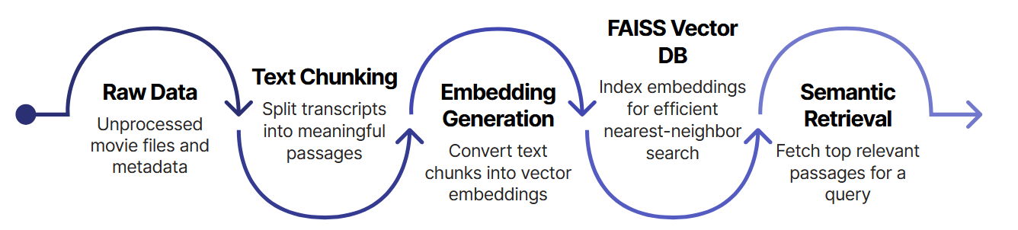
System Architecture
The pipeline transforms raw movie data into semantically indexed chunks, retrieves the most relevant passages at query time, and passes them as context to the LLM ensuring every answer is grounded in real source material.
Tools Used
FAISS : Fast similarity search over dense vector embeddings
LangChain : Orchestration layer connecting retrieval and generation
HuggingFace : Embedding models and tokenization
Ollama : Local LLM inference for Llama3, Mistral, and Phi3

Slide 8
Implementation Overview
Our RAG pipeline was meticulously built and tested through a series of key development stages, integrating specialized tools for each step of the process.
Data Ingestion : Movie data, including plots, characters, and dialogues, was loaded and prepared.
Text Chunkin : Raw text was divided into manageable, context-rich chunks for processing.
Embedding Creation : Chunks were converted into numerical vector embeddings using robust models.
FAISS Storage : Embeddings were efficiently stored and indexed in a FAISS vector database.
Semantic Retrieval : Relevant data was retrieved based on query similarity during inference.
LLM Generation : Locally deployed LLMs generated accurate answers using the retrieved context.
For local LLM inference, we utilized Ollama to deploy and test several cutting-edge models, including:
Llama3
Mistral
Phi3

Slide 9
Evaluation Metrics
Accuracy How correct the answer is based on movie data
Reasoning How well the model explains why
Emotion Understanding Ability to capture character feelings and psychology
Hallucination Whether the model adds incorrect or unrelated information
Compared answers across 3 models
Focused on reasoning + emotional understanding
Evaluated both short and deep questions
Used RAG-based answers for better accuracy

Slide 10
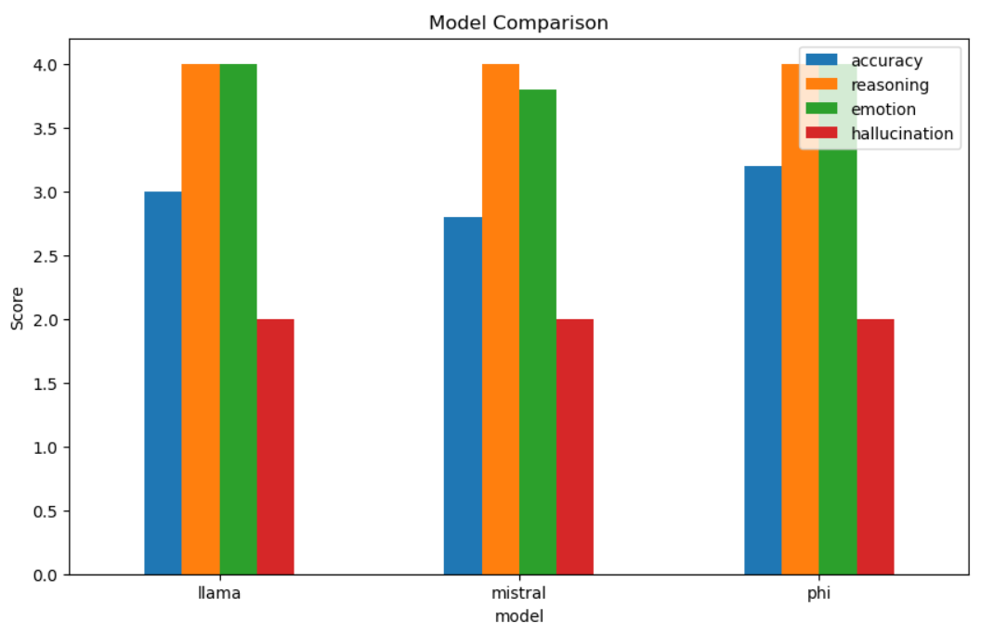
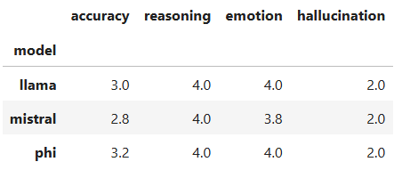
Model Comparison & Results
A deeper look into how each LLM performs across critical metrics, including accuracy, reasoning capabilities, emotional intelligence, and hallucination rates within our RAG framework.
Phi-3: Small but Powerful LeaderDespite its smaller size, Phi-3 emerged as the best-performing model overall, demonstrating superior accuracy and matching Llama 3 in reasoning and emotional intelligence. Its consistent hallucination rate across all models highlights the RAG system's effectiveness in grounding responses.

Slide 11
Model Analysis : Strengths and Weaknesses
Phi3
Best Strength: Achieved the highest accuracy for its compact size, demonstrating strong reasoning and emotional intelligence.
Weakness: May offer less exhaustive detail compared to larger models for extremely complex, nuanced narratives
Llama3
Strength: Produces detailed, narrative-rich responses with robust multi-step reasoning and emotional understanding.
Weakness: Slightly lower overall accuracy than Phi-3, and can sometimes be verbose.
Mistral
Strength: Efficient and robust, offering strong reasoning capabilities and good emotional intelligence.
Weakness: Showed slightly lower overall accuracy in this evaluation compared to Phi-3 and Llama3.

Slide 12
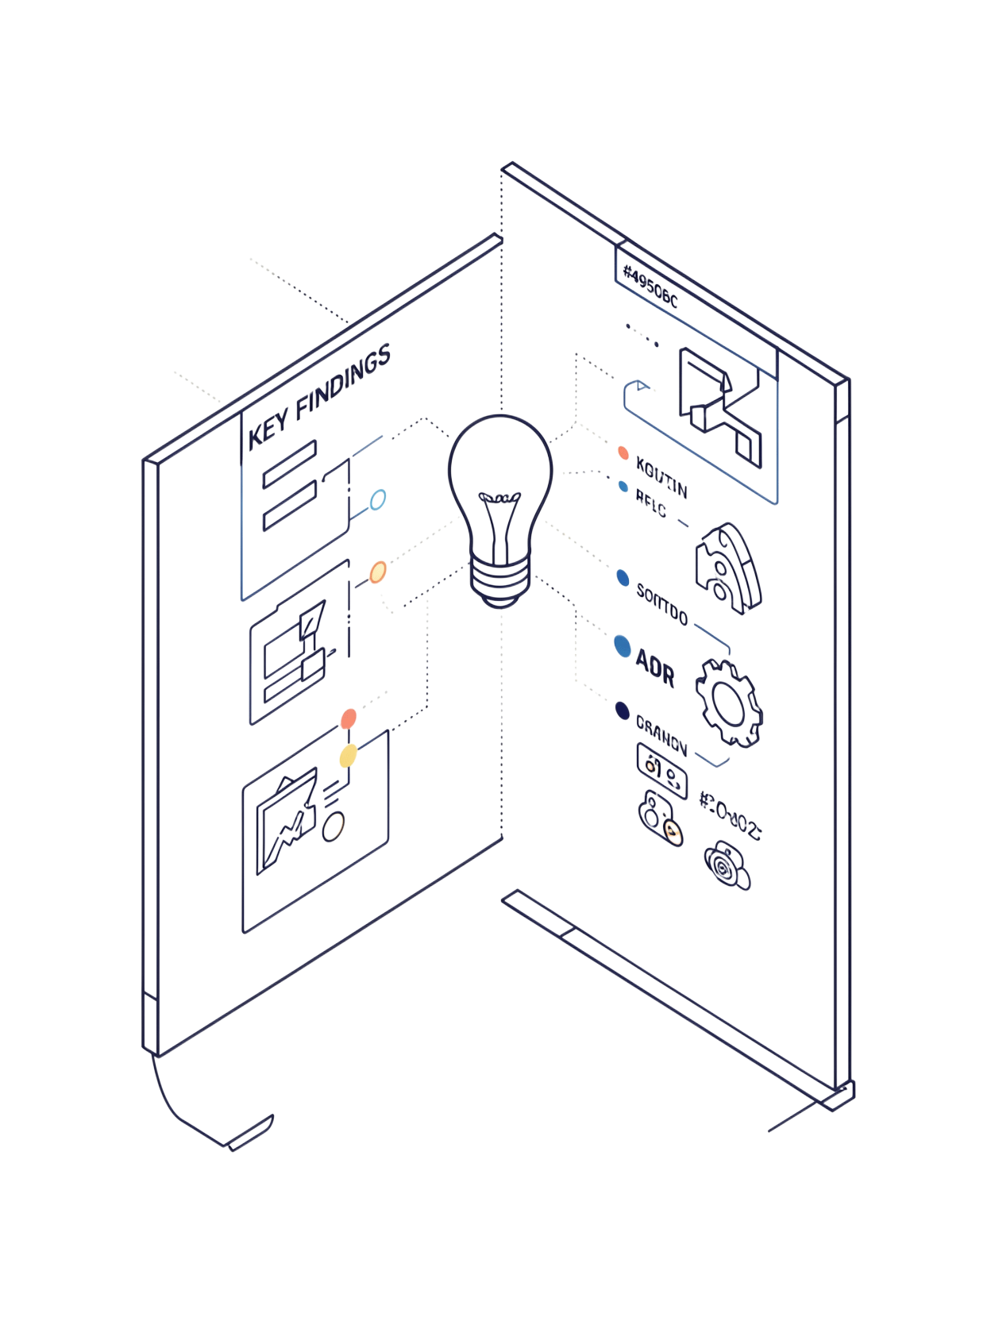
Key Findings
RAG Dramatically Reduces Hallucination Grounding responses in retrieved source passages prevents models from fabricating plot details or character motivations.
Context-Aware Answers Improve Reasoning Depth All three models produced significantly more nuanced answers when augmented with relevant movie data versus raw prompting.
Model Choice Remains Critical RAG improves every model's output, but the underlying LLM still determines reasoning quality Phi consistently led across all metrics.

Slide 13
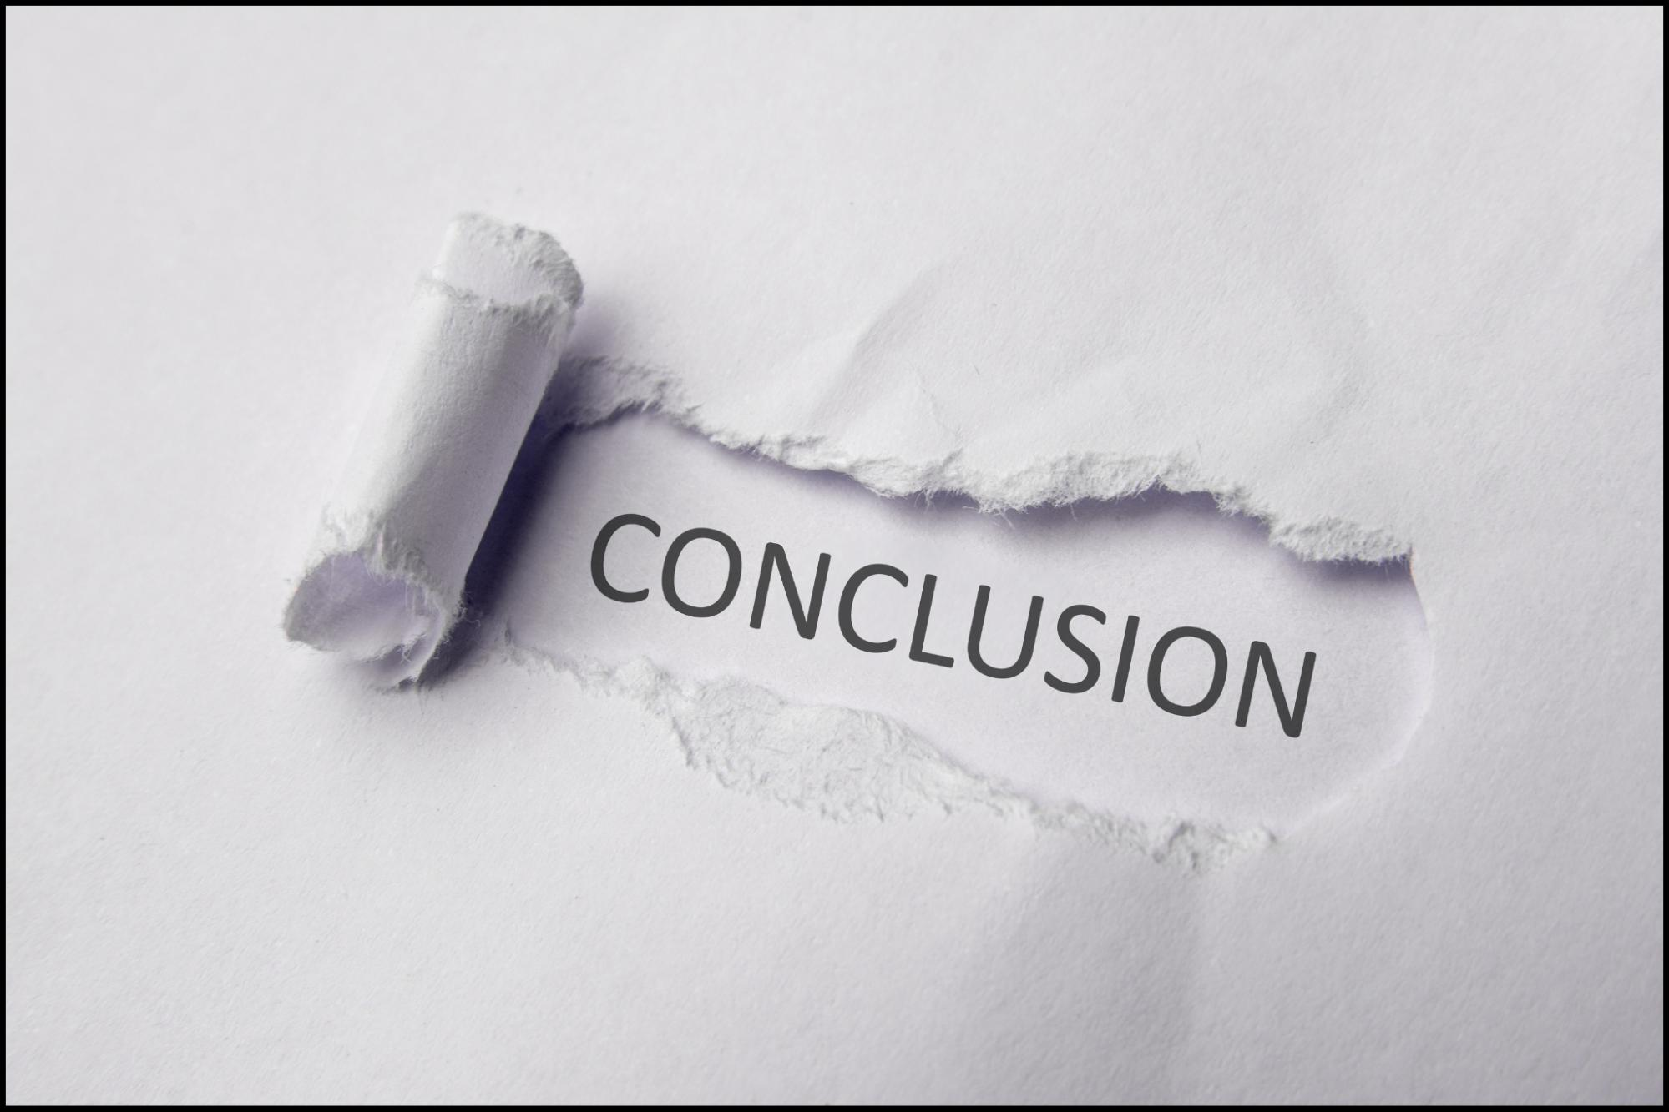
Conclusion & Future Directions
What We Achieved
Built a complete RAG pipeline for movie QA using FAISS, LangChain, and Ollama
Benchmarked Llama3, Mistral, and Phi3 across five evaluation dimensions
Demonstrated that RAG meaningfully improves grounding, accuracy, and reasoning
Phi-3 emerged as the best-performing model overall with strong accuracy
What's Next
Expand the corpus to 20+ films across diverse genres
Integrate a real-time conversational chatbot interface
Experiment with larger frontier models (Llama3-70B, Mixtral)
Build an evaluation harness for automated metric scoring
This project demonstrates that RAG is a viable and powerful framework for domain-specific deep-reasoning tasks beyond traditional QA.

Slide 14

Thank You

